Slide 1
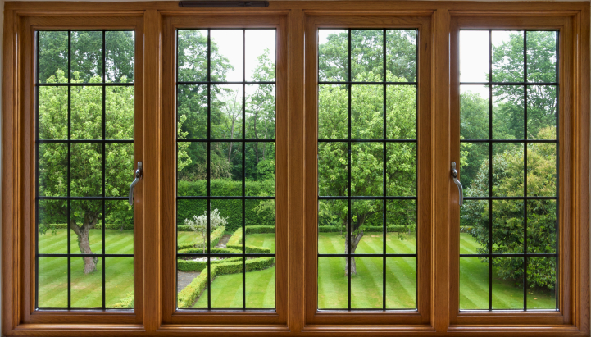
Virtual
Library
Welcome to Hillside Primary School’s first ever virtual library!
On the next page you will find our menu with links to lots of different types of books. Click on one of the signs and it will take you to all the books in that section. When you’ve chosen a book, click on the image of that book and it will take you to the video link.
Happy reading!

Slide 2
Picture Books
All Kinds of Families
Stories about Children
Everyone is Welcome!
Julia Donaldson
Black Lives Matter
Stories about Animals
Be Proud of Who You Are!
A Collection of Different Stories
Little People, Big Dreams Series
Empathy, Kindness and Compassion
You Can be Anything!
Similarities and Differences
Feelings and Emotions

Slide 3
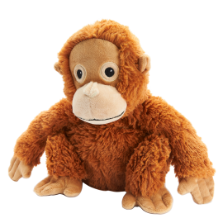
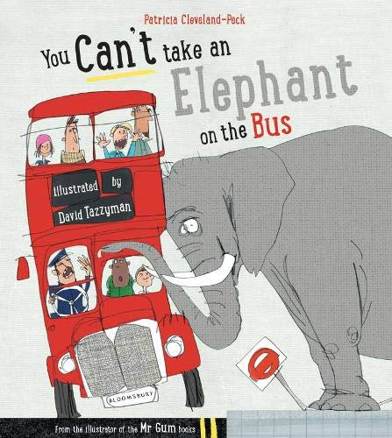
Picture Books

Slide 4
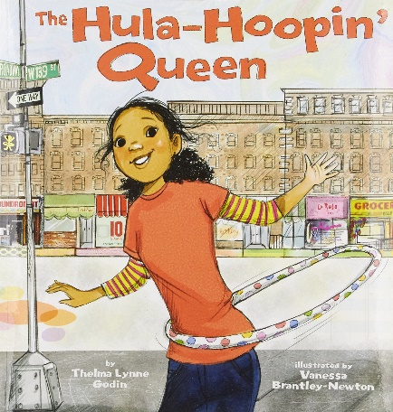
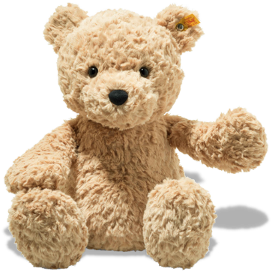
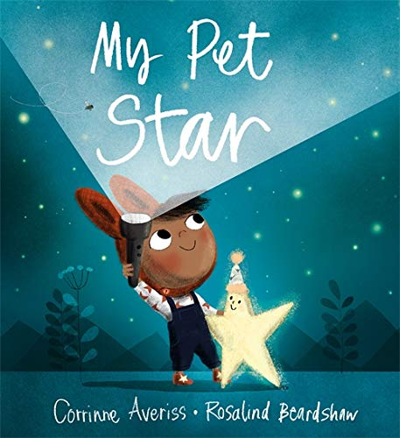
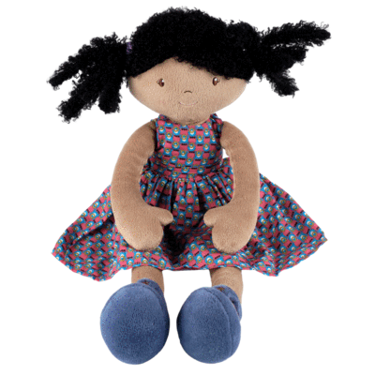
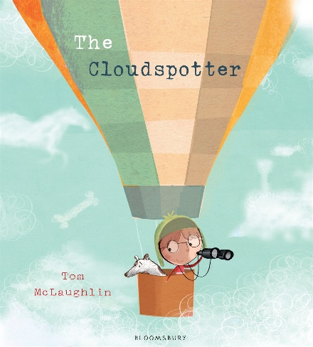
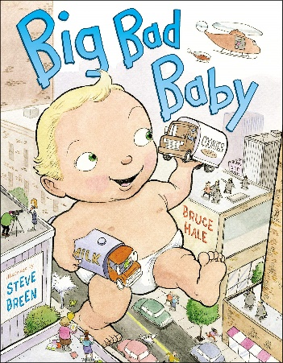
Stories about Children

Slide 5
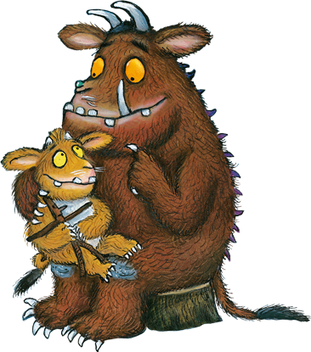
Julia Donaldson

Slide 6
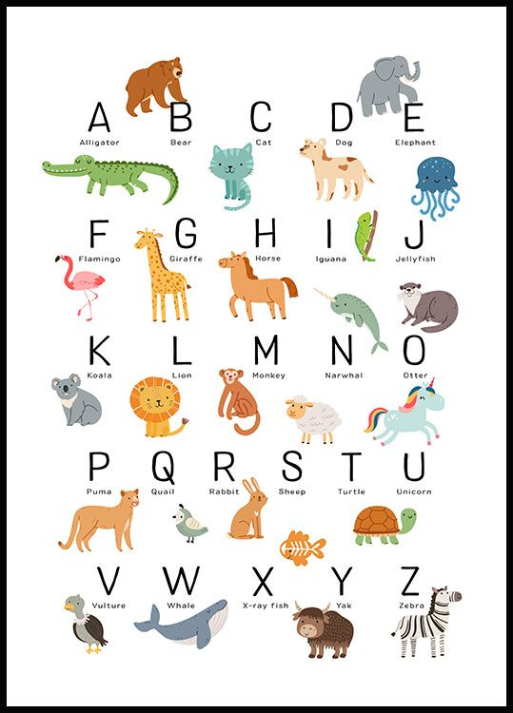
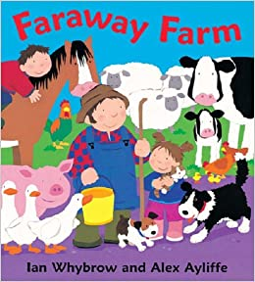
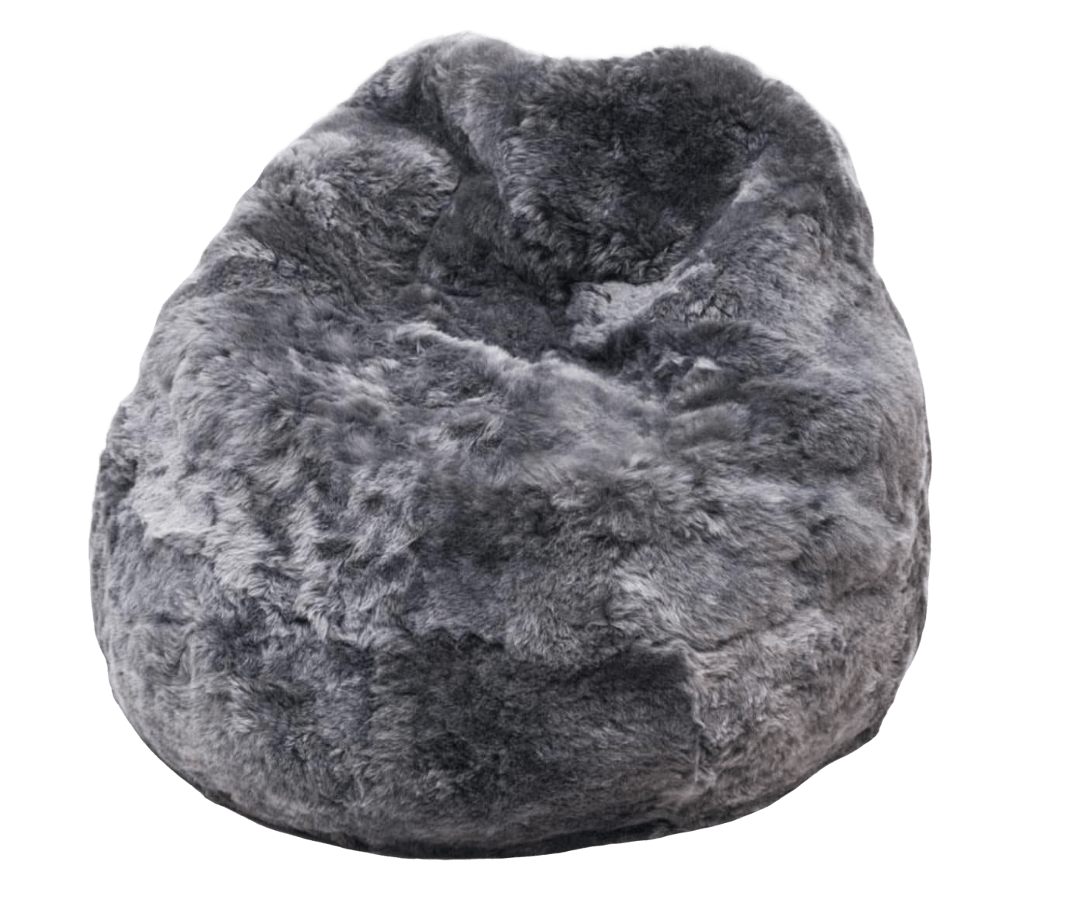
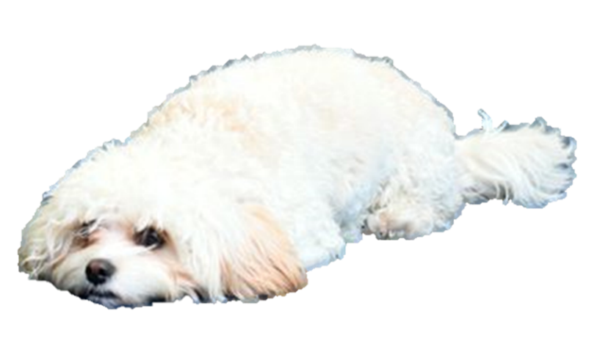
Stories about Animals

Slide 7
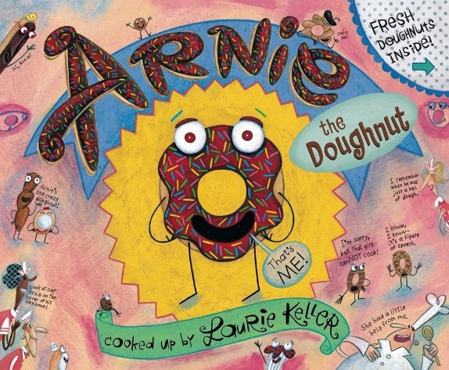
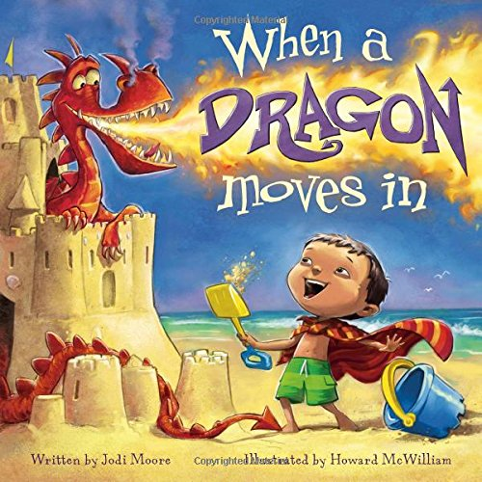
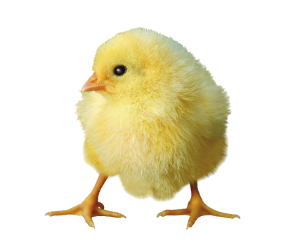
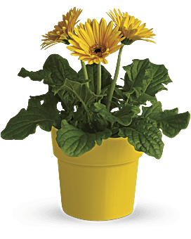
A Collection of Different Stories

Slide 8
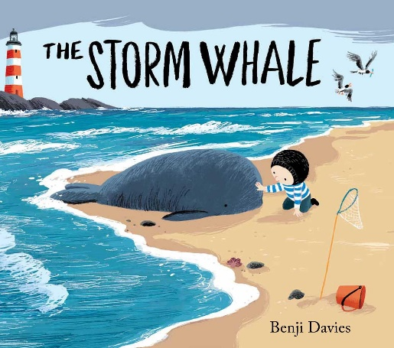
Empathy, Kindness and Compassion

Slide 9
Similarities and Differences

Slide 10
All Kinds of Families

Slide 11
Everyone is Welcome!

Slide 12
Black Lives Matter

Slide 13
Be Proud of Who You Are!

Slide 14
Little People, Big Dreams Series
This is only a selection of the series, there are many more in the collection!
What other influential people can you find out about?

Slide 15
You Can Be Anything!

Slide 16
Feelings and Emotions

