Slide 1
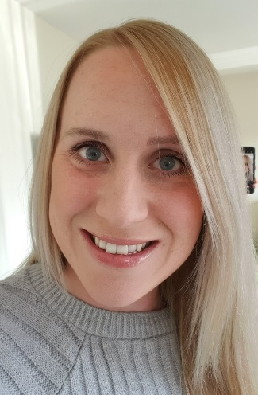
Nursery Overview 6th September 2022

Slide 2
Topics During the Year NB: These may be subject to change depending on the needs of the cohort
 | Autumn | Spring | Summer
Topics | All about Me Colour Winter | On the Farm Spring | Travel and Transport Summer
PSED (3D PSHE) | Self-Regulation Managing Self Building Relationships | Self-Regulation Managing Self Building Relationships | Self-Regulation Managing Self Building Relationships
CLLD | Circle time Story time Nursery Rhymes / Singing Little Ted’s Adventures Role Play – Home Corner | Circle time Story time Nursery Rhymes / Singing Little Ted’s Adventures Role Play – Farm / Farm Shop | Circle time Story time Nursery Rhymes / Singing Little Ted’s Adventures Role Play - Airport
UW | RE- Christmas Science – humans, senses, weather / seasonal change forest school History –Guy Fawkes, Remembrance | RE –Easter Science - forest school, weather / seasonal change observations plants animals History – life-cycles | Science - floating/sinking forest school weather / seasonal change materials Geog – Holidays on the map , French Day History – talking about own holidays
EAD | Art, Music, Dance, Drama Through Topic Work | Art, Music, Dance, Drama Through Topic Work | Art, Music, Dance, Drama Through Topic Work
PD | Multi Skills | Multi Skills | Gymnastics

Slide 3
English During the Year NB: These may be subject to change depending on the needs of the cohort
English in Nursery
 | Autumn |  | Spring |  | Summer
Topic | All About Me | Colours / Celebrations | People Who Help Us | On The Farm | Travel and Transport | Holidays
Suggested Texts | You Choose! Only one You Marvellous Me The Colour Monster Ten little fingers and ten little toes | Elmer the Elephant The story of Rama and Sita The Jolly Christmas Postman | Emergency! Vicky the Vets When I grow up | A Squash and a Squeeze Old McDonald Had a farm Oliver’s Vegetables Jack and the Beanstalk | Wheels on the bus Duck in the truck Emma Jane’s Aeroplane | Lucy and Tom at the Seaside Tiddler Meg at Sea
Possible writing Opportunities | Drawing self-portraits / family members Name writing | Animal alliteration Retelling / Story sequencing | Drawing what I want to be when I’m older Emergency Stories Labelling pictures | Sequencing instructions Writing a list Writing invitations | Labelling people on a bus Rhyming couplets Creating a passport | Writing holiday list Writing postcards Drawing and labelling sea creatures Retelling and labelling the story / writing captions

Slide 4
Maths During the Year NB: These may be subject to change depending on the needs of the cohort
Nursery | Week 1 | Week 2 | Week 3 |  |  | Week 4 | Week 5 | Week 6 | Week 7 | Week 8 | Week 9 |  | Week 10 | Week 11 | Week 12
Autumn | Number Songs | Colours |  |  |  | Matching |  | Sorting |  | Comparing Amounts |  |  | Compare Size, Mass and Capacity |  | Simple Patterns
Spring | Number 1 |  |  | Weight |  |  | Number 2 |  | Number 3 |  |  | Length and Height |  | Number 4
Summer | Number 5 |  |  |  | 1 More and 1 less |  | Shapes |  | My Day |  |  | Capacity |  | Positional Language

Slide 5
Planned Visits and Events NB: Dates will be confirmed closer to the events
Autumn – Christmas Church service
Showcase
Santa Visit
Walk to the postbox
Spring – Easter church visit
Mother’s Day assembly & refreshments
Farm on wheels (tbc)
Summer – Manchester Runway Park (tbc)
Father’s Day Afternoon tea & crafts
Sports Day

Slide 6
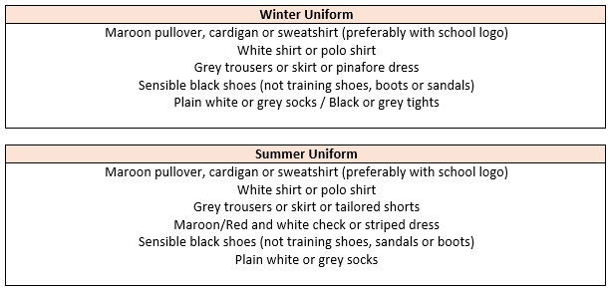
Uniform Expectations
Hair:
Long hair (below shoulder length) should be tied back. Hair accessories should be minimal, plain and in
school colours. Hair should be kept out of children’s eyes using headbands, clips and slides; again plain
using school colours. During term-time, pupils are asked not to have fashion hairstyles, which include:
shaved, dyed or streaked hair, patterns, mohawks, lines and tramlines. Hair braids, tinsels and feathers
should not be worn.
Jewellery, Make-up and Nails:
Watches and plain stud earrings can be worn. Plain stud earrings are defined as silver or gold,
spherical shaped and small. Plastic safety studs will be permitted. Pupils are not allowed to wear any make-up
or false nails to school.

Slide 7
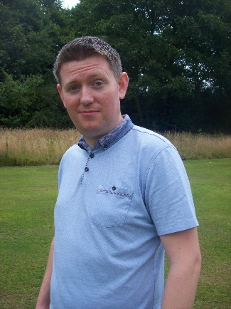
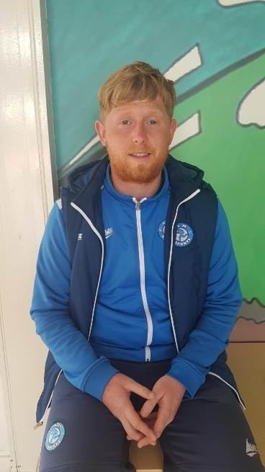
PE and Music
Your child will have PE on a Tuesday with Dan.
They will have Music on Tuesday with Mr. Hall.
On PE days, children are expected to come to school dressed in their PE uniform, with no ear-rings and long hair tied back.
Uniform:
Maroon t-shirt with Hillside lettering, plain black shorts
or tracksuit bottoms (no stripes or logos) and trainers
with plain socks.
Hair:
Long hair (below shoulder length) must be tied back.
Physical Education:
Earrings for PE:
All forms of body piercing MUST be removed before children take part in physical education or undertake any physical activities (Plastic safety studs will be permitted). If the body piercing is not removed the child will NOT be allowed to take part in any physical education lesson or activity.

Slide 8
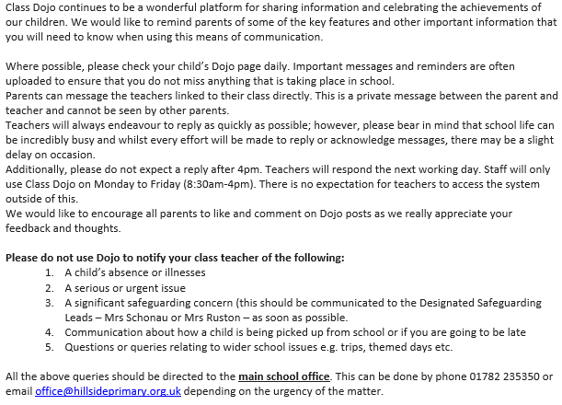
Communication – Dojo

Slide 9
Homework and Reading
Your child is expected to read with you at home at least three times a week and this is to be noted in their reading diary. If they read three times a week they are entered in to the Reading Rocket and get a letter home, extra play and a chance to win a prize! We also offer extra prizes to the class that has the most children entered in to the Reading Rocket!
Homework – after Christmas children will be sent home with a ‘Scribbler’ book. This is an optional task that complements the learning that has been taking place in Nursery that week. More details will follow with the book.

Slide 10
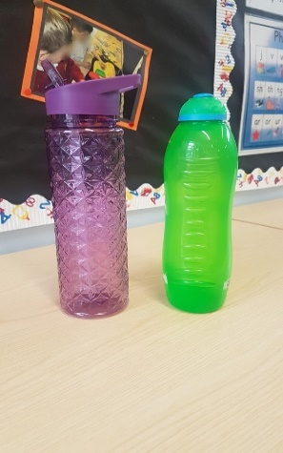
Reminders
Nursery are provided with a piece of fruit for their snack each day.
Each child should have a water bottle in school each day (please no glass). This is to be taken home each day and brought back in refilled with water. It can be refilled throughout the day from our water dispensers.
PLEASE send your child with appropriate clothing for
the weather – coats, hats, gloves, sun hats, sun cream
as appropriate. Thank you!

Slide 11
Behaviour
Children are expected to follow our Hillside Rules to:
Stay Safe
Show Respect
Be kind
Positive behaviour is rewarded at Hillside in lots of ways including:
Marbles for top teams and individual behaviour!
End of the week treats!
Head Teacher Certificates and Good Worker Awards!
Prize draws for Reading Rocket…
We follow our behaviour consequence system if we need to (see in class) and this is used consistently throughout the school.

Slide 12
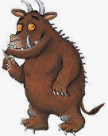
Extra-curricular Clubs NB: Dates and clubs will be confirmed closer to the events
Multi-skills with Dan!

Slide 13
Any Questions?

