Slide 1
Meet the Teacher Year Two 6th September 2022

Slide 2
Topics During the Year NB: These may be subject to change depending on the needs of the cohort

Slide 3
Planned Visits and Events NB: Dates will be confirmed closer to the events
Autumn – tbc
Spring – Gladstone Pottery Museum
Summer – tbc
Autumn – Christmas
Spring – Showcase
Summer – Showcase
Summer – Sports Day

Slide 4
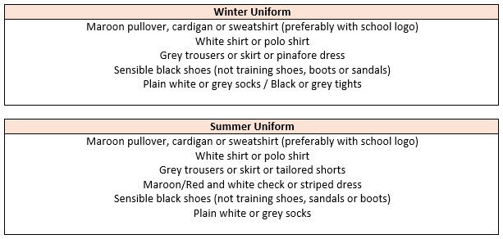
Uniform Expectations
Hair:
Long hair (below shoulder length) should be tied back. Hair accessories should be minimal, plain and in
school colours.
During term-time, pupils are asked not to have fashion hairstyles, which include:
shaved, dyed or streaked hair, patterns, mohawks, lines and tramlines. Hair braids, tinsels and feathers should not be worn.
Jewellery, Make-up and Nails:
Watches and plain stud earrings can be worn. Plain stud earrings are defined as silver or gold,
spherical shaped and small.
Pupils are not allowed to wear any make-up or false nails to school.

Slide 5
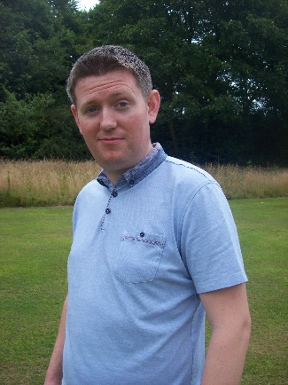
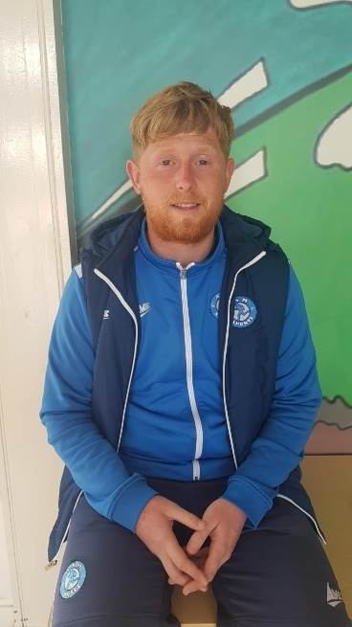
PE and Music
Your child will have PE on a Tuesday with Dan and on a Friday with Mr Mellor.
They will have Music on Tuesday with Mr Hall.
On PE days, children are expected to come to school dressed in their PE uniform, with no ear-rings and long hair tied back.
PE Kit:
Maroon t-shirt with Hillside lettering, plain black shorts
or tracksuit bottoms (no stripes or logos) and trainers
with plain socks.
Hair:
Long hair (below shoulder length) must be tied back.
Earrings for PE:
All forms of body piercing must be removed before children take part in physical education or undertake any physical activities, unless discussed with Mr Mellor.

Slide 6
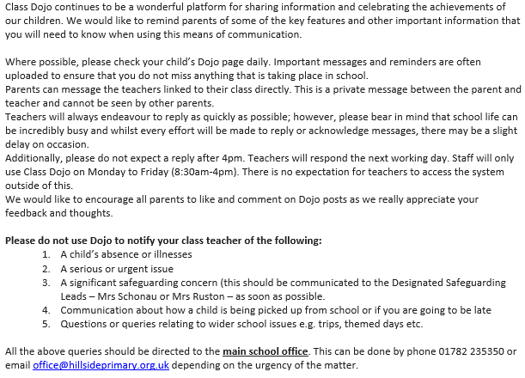
Communication – Dojo

Slide 7
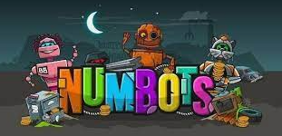
Homework and Reading
Your child’s weekly maths homework will be in two parts. First, there will be a sheet stuck into a maths homework book linked to the learning from the week’s lessons. Second, your child will need to login to TT Rockstars (Or Numbots) and play three games. The login will be in their reading diary.
Your child will also receive English spelling homework weekly, linked to the phonics sound or spelling rule that they have been learning. In addition, they will be set online spelling homework via Spelling Shed. The login will be in their reading diary. This will help to embed the sound and on the Friday, we will complete a small spelling test.
Your child is expected to read with you at home at least three times a week and this is to be noted in their reading diary. If they read five times a week they are entered in to the Reading Rocket and get a letter home, extra play and a chance to win a bigger prize! We also offer extra prizes to the class that has the most children entered in to the Reading Rocket! If your child finishes their books early, re-reading books and performing books is really useful for developing fluency.

Slide 8
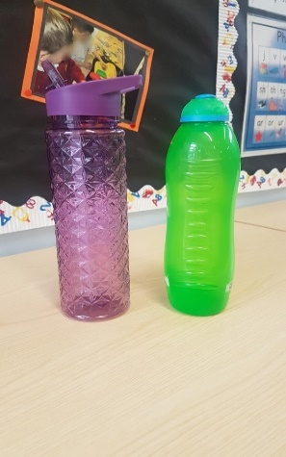
Reminders
Nursery, Reception, Year One and Year Two are provided with a piece of fruit for their snack each day. Children are welcome to bring their own healthy snack in to eat at playtime should they prefer. This can be a piece of fruit/ breakfast bar etc. (we are a nut free school so no items containing nuts and no chocolate/ crisps please)
Each child should have a water bottle in school each day (please no glass). This is to be taken home each day and brought back in refilled with water only. It can be refilled throughout the day from our water dispensers.
Please send your child with appropriate clothing for
the weather – coats, hats, gloves, sun hats, sun cream
as appropriate. Thank you!

Slide 9
Behaviour
Children are expected to follow our Hillside Rules to:
Stay Safe
Show Respect
Be kind
Positive behaviour is rewarded at Hillside in lots of ways including:
Marbles for top teams and individual behaviour!
End of the week treats!
Head Teacher Certificates and Good Worker Awards!
Prize draws for Reading Rocket…
We follow our behaviour consequence system if we need to (see in class) and this is used consistently throughout the school.

Slide 10
Statutory Testing
In Year Two the children complete KS1 SATS. This usually happens in the first few weeks of the Summer Term in May and is a Statutory Test that is reported to the Local Authority. It helps to identify gaps so the best possible start can be made to their KS2 journey in year 3.
The children sit the following tests:
They are not strictly timed and will take place in the classroom. Afterwards, they will be marked by Mr Mellor in school.
Most of the preparation is incorporated into the normal routine. Children will not be aware they are completing SATS as it is very similar to assessment week that occurs in each year group three times a year.
It is nothing to worry about. You will find out more about this closer to the time!

Slide 11
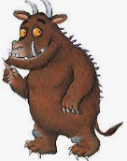
Extra-curricular Clubs NB: Dates and clubs will be confirmed closer to the events
Multi-skills with Dan in Autumn.
To be confirmed over the next week.
Clubs tbc for the Spring and Summer term.

Slide 12
Any Questions?

