Slide 1
Meet the Teacher Year Three 6th September 2022

Slide 2
Topics During the Year NB: These may be subject to change depending on the needs of the cohort

Slide 3
Topics During the Year NB: These may be subject to change depending on the needs of the cohort

Slide 4
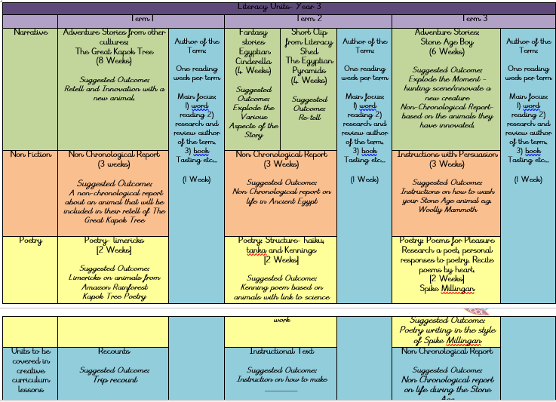
English During the Year

Slide 5
Maths During the Year

Slide 6
Planned Visits and Events NB: Dates will be confirmed closer to the events and trips may change due to availability and cost
Autumn – Brazil themed day in school
Spring – Egyptian themed trip
Summer – TBC- In school visitor/ themed day
Autumn – Showcase
Spring – Whole Class Assembly
Summer – Showcase
Summer – Sports Day

Slide 7
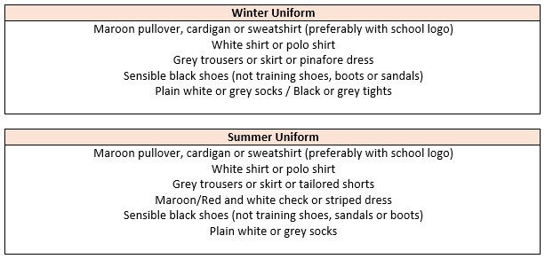
Uniform Expectations
Hair:
Long hair (below shoulder length) should be tied back. Hair accessories should be minimal, plain and in
school colours. Hair should be kept out of children’s eyes using headbands, clips and slides; again plain
using school colours. During term-time, pupils are asked not to have fashion hairstyles, which include:
shaved, dyed or streaked hair, patterns, mohawks, lines and tramlines. Hair braids, tinsels and feathers
should not be worn.
Jewellery, Make-up and Nails:
Watches and plain stud earrings can be worn. Plain stud earrings are defined as silver or gold,
spherical shaped and small. Pupils are not allowed to wear any make-up or false nails to school.

Slide 8
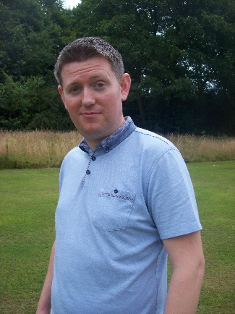
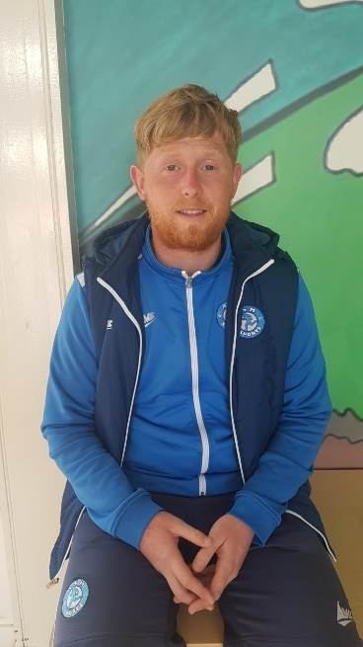
PE and Music
Your child will have PE on a Monday with me and on Wednesday with Dan.
They will have Music on Wednesday with Mr. Hall.
On PE days, children are expected to come to school dressed in their PE uniform, with no earrings and long hair tied back.
Uniform:
Maroon t-shirt with Hillside lettering, plain black shorts
or tracksuit bottoms (no stripes or logos) and trainers
with plain socks.
Hair:
Long hair (below shoulder length) must be tied back.
Earrings for PE:
All forms of body piercing MUST be removed before children take part in physical education or undertake any physical activities. If the body piercing is not removed the child will NOT be allowed to take part in any physical education lesson or activity.
Please note- In exceptional circumstances where a parent reports an issue with this ( i.e fast healing / pain etc) we are allowing soft, clear plastic retainers to be worn.

Slide 9
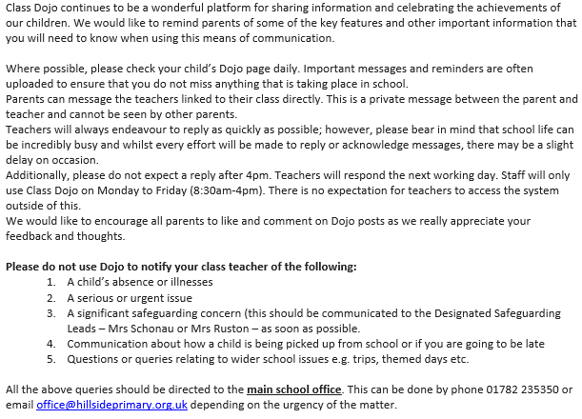
Communication – Dojo

Slide 10
Homework and Reading
Your child will be set Mathematics homework weekly and this will be linked to the learning from the week’s lessons. Children are also asked to complete at least three games on Times Table Rock stars to support their quick recall of times tables. A regular leader board is shared by Mrs Wainwright. The login will be in their reading diary.
Your child will also receive English spelling homework every other week, linked to the spelling rules that they have been learning. This will give them the opportunity to practise their spelling and handwriting. In addition, they will be set online spelling homework via Spelling Shed. The login will be in their reading diary.
Your child is expected to read with you at home at least three times a week and this is to be noted in their reading diary. If they read five times a week they are entered in to the Reading Rocket and get a letter home, extra play and a chance to win a bigger prize! We also offer extra prizes to the class that has the most children entered in to the Reading Rocket!

Slide 11
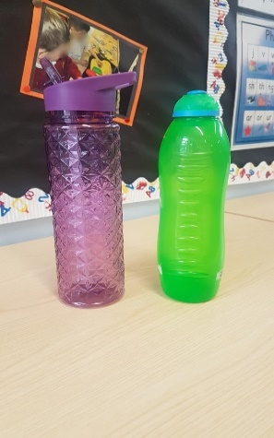
Reminders
Children in Year Three are no longer provided with a piece of fruit at playtime. Children are welcome to bring their own healthy snack in to eat. This can be a piece of fruit/ breakfast bar etc. (we are a nut free school so no items containing nuts and no chocolate/ crisps please).
Each child should have a water bottle in school each day (please no glass). This is to be taken home each day and brought back in refilled with water. It can be refilled throughout the day from our water dispensers.
PLEASE send your child with appropriate clothing for
the weather – coats, hats, gloves, sun hats, sun cream
as appropriate. Thank you!

Slide 12
Behaviour
Children are expected to follow our Hillside Rules to:
Stay Safe
Show Respect
Be kind
Positive behaviour is rewarded at Hillside in lots of ways including:
Marbles for top teams and individual behaviour!
End of the week treats!
Head Teacher Certificates and Good Worker Awards!
Prize draws for Reading Rocket…
We follow our behaviour consequence system if we need to (see in class) and this is used consistently throughout the school.

Slide 13
Extra-curricular Clubs NB: Dates and clubs will be confirmed closer to the events
Singing Stars with Mr. Hall!
Autumn – Multi-skills
Spring – Multi-skills with Dan
French club with Miss Nelson

Slide 14
Any Questions?

