Slide 1
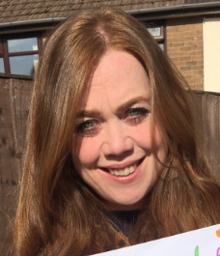
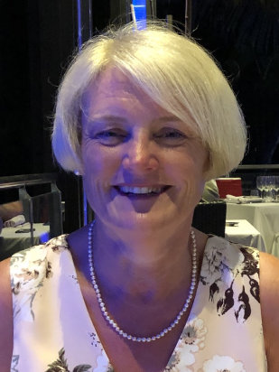
Meet the Teacher 6th September 2022

Slide 2
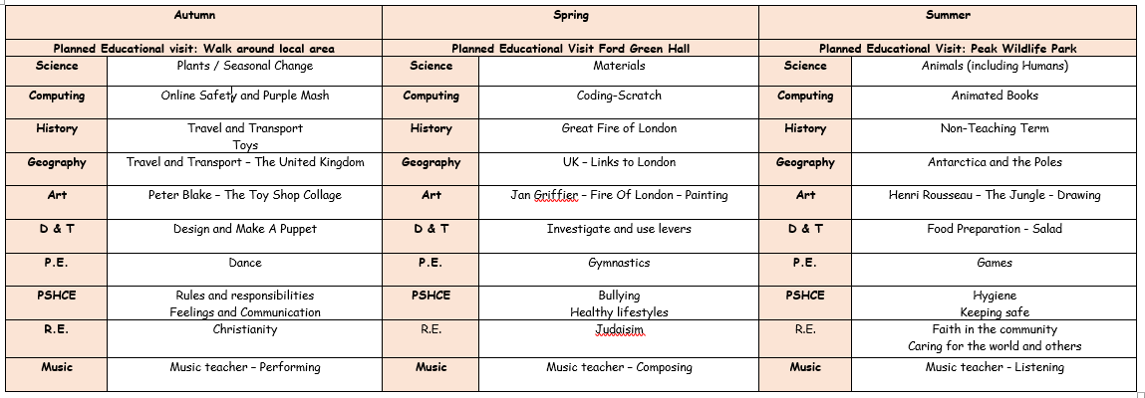
Topics During the Year NB: These may be subject to change depending on the needs of the cohort

Slide 3
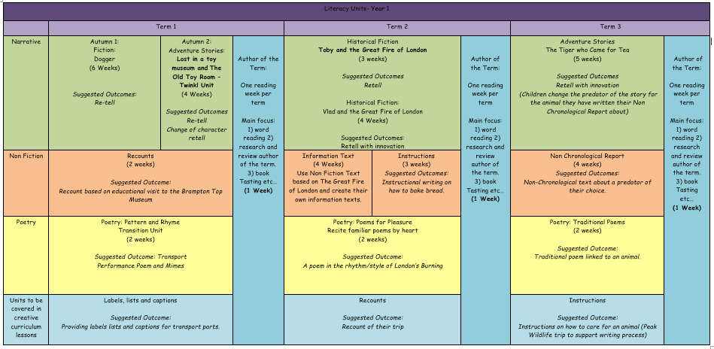
English During the Year NB: These may be subject to change depending on the needs of the cohort

Slide 4
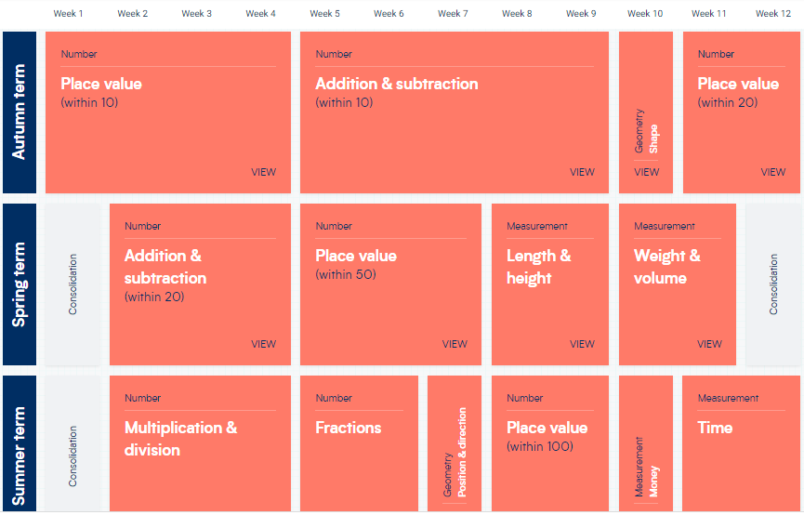
Maths During the Year NB: These may be subject to change depending on the needs of the cohort

Slide 5
Planned Visits and Events NB: Dates will be confirmed closer to the events
Autumn – Local Walk around Milton
Spring – Ford Green Hall Visit
Summer – Peak Wildlife Park Visit
Autumn – Showcase
Spring – Whole Class Assembly
Summer – Showcase
Summer – Sports Day

Slide 6
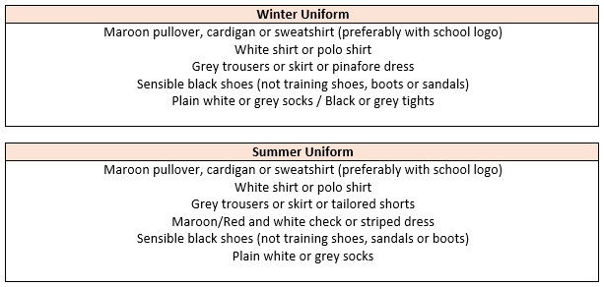
Uniform Expectations
Hair:
Long hair (below shoulder length) should be tied back. Hair accessories should be minimal, plain and in
school colours. Hair should be kept out of children’s eyes using headbands, clips and slides; again plain
using school colours. During term-time, pupils are asked not to have fashion hairstyles, which include:
shaved, dyed or streaked hair, patterns, mohawks, lines and tramlines. Hair braids, tinsels and feathers
should not be worn.
Jewellery, Make-up and Nails:
Watches and plain stud earrings can be worn. Plain stud earrings are defined as silver or gold,
spherical shaped and small. Pupils are not allowed to wear any make-up or false nails to school.

Slide 7
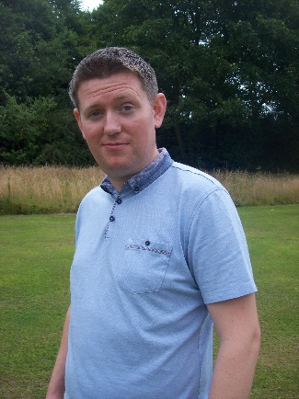
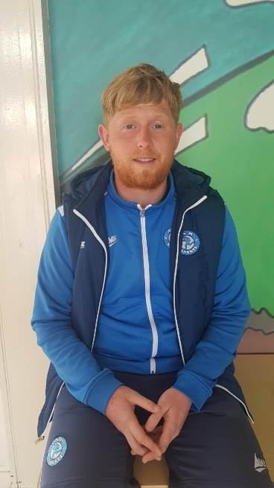
PE and Music
Your child will have PE on a Tuesday and Thursday with Dan.
They will have Music on Tuesday with Mr. Hall.
On PE days, children are expected to come to school dressed in their PE uniform, with no ear-rings and long hair tied back.
Uniform:
Maroon t-shirt with Hillside lettering, plain black shorts
or tracksuit bottoms (no stripes or logos) and trainers
with plain socks.
Hair:
Long hair (below shoulder length) must be tied back.
Physical Education:
Earrings for PE:
All forms of body piercing MUST be removed before children take part in physical education or undertake any physical activities. If the body piercing is not removed the child will NOT be allowed to take part in any physical education lesson or activity.

Slide 8
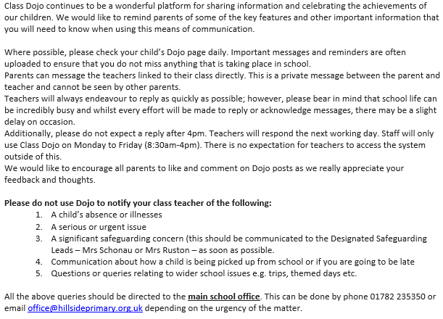
Communication – Dojo

Slide 9
Homework and Reading
Your child will be set Mathematics homework weekly and this will be linked to the learning from the week’s lessons. There will be an online warm-up too for them to play. Your child will also have access to Numbots to play at home if they choose which practises key skills. The login will be in their reading diary.
Your child will also receive English spelling homework weekly, linked to the phonics sounds that they have been learning. This will give them the opportunity to practise their spelling and handwriting. In addition, they will be set online spelling homework via Spelling Shed. The login will be in their reading diary.
Your child is expected to read with you at home at least three times a week and this is to be noted in their reading diary. If they read five times a week they are entered in to the Reading Rocket and get a letter home, extra play and a chance to win a bigger prize! We also offer extra prizes to the class that has the most children entered in to the Reading Rocket!

Slide 10
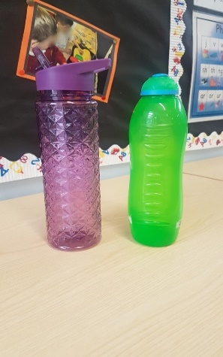
Reminders
Nursery, Reception, Year One and Year Two are provided with a piece of fruit for their snack each day. Children are welcome to bring their own healthy snack in to eat at playtime should they prefer. This can be a piece of fruit/ breakfast bar etc. (we are a nut free school so no items containing nuts and no chocolate/ crisps please)
Each child should have a water bottle in school each day (please no glass). This is to be taken home each day and brought back in refilled with water. It can be refilled throughout the day from our water dispensers.
PLEASE send your child with appropriate clothing for
the weather – coats, hats, gloves, sun hats, sun cream
as appropriate. Thank you!

Slide 11
Behaviour
Children are expected to follow our Hillside Rules to:
Stay Safe
Show Respect
Be kind
Positive behaviour is rewarded at Hillside in lots of ways including:
Marbles for top teams and individual behaviour!
End of the week treats!
Head Teacher Certificates and Good Worker Awards!
Prize draws for Reading Rocket…
We follow our behaviour consequence system if we need to (see in class) and this is used consistently throughout the school.

Slide 12
Statutory Testing
In Year One the children complete the Phonics Screening Check. This usually happens in June and is a Statutory Test that is reported to the Local Authority.
The test contains 40 words. Each child will sit one-to-one and read each word aloud to a teacher. The test will take approximately 10 minutes per child, although all children are different and will complete the check at their own pace.
The list of words the children read is a combination of 20 real words and 20 pseudo words (nonsense words). The pseudo words will be shown to your child with a picture of an alien. Pseudo words are included because they will be new to all pupils; they do not favour children with a good vocabulary knowledge or visual memory of words.
You will find out more about
this closer to the time!

Slide 13
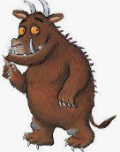
Extra-curricular Clubs NB: Dates and clubs will be confirmed closer to the events
Singing Stars with Mr. Hall!
Autumn – Story and Rhyme Craft Club with Mrs. Rushton
Spring – Multi-skills with Dan

Slide 14
Any Questions?

