Slide 1
Meet the Teacher 6th September 2022

Slide 2
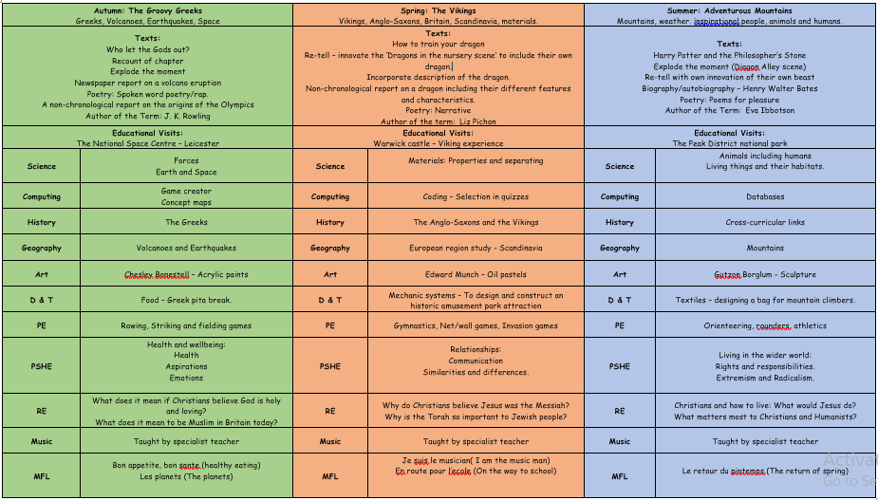
Topics During the Year NB: These may be subject to change depending on the needs of the cohort

Slide 3
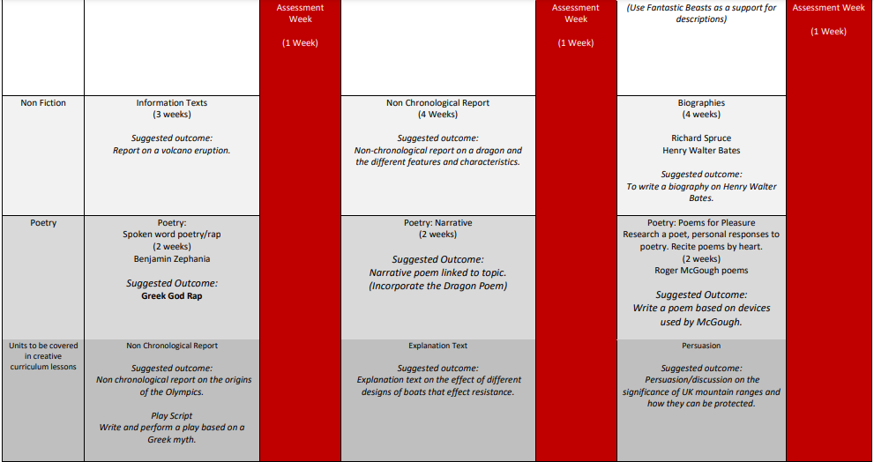
English During the Year NB: These may be subject to change depending on the needs of the cohort

Slide 4
Maths During the Year NB: These may be subject to change depending on the needs of the cohort

Slide 5
Planned Visits and Events NB: Dates will be confirmed closer to the events
Autumn – STEM Day at RAF Museum
Spring – Hanley Museum Anglo-Saxon and Vikings Workshops
Summer – Stanley Head
Autumn – Harvest Assembly/Showcase
Summer – Showcase
Summer – Sports Day

Slide 6
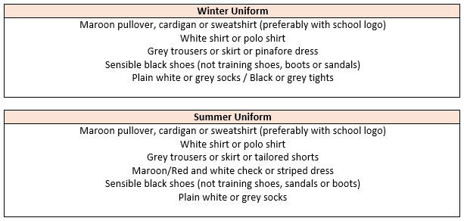
Uniform Expectations
Hair:
Long hair (below shoulder length) should be tied back. Hair accessories should be minimal, plain and in
school colours. Hair should be kept out of children’s eyes using headbands, clips and slides; again plain
using school colours. During term-time, pupils are asked not to have fashion hairstyles, which include:
shaved, dyed or streaked hair, patterns, mohawks, lines and tramlines. Hair braids, tinsels and feathers
should not be worn.
Jewellery, Make-up and Nails:
Watches and plain stud earrings can be worn. Plain stud earrings are defined as silver or gold,
spherical shaped and small. Pupils are not allowed to wear any make-up or false nails to school.

Slide 7
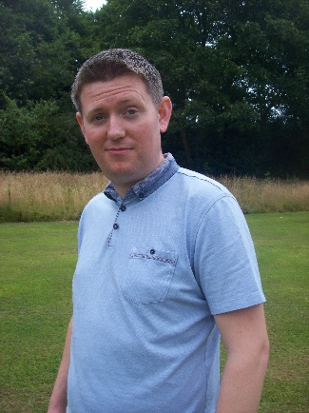
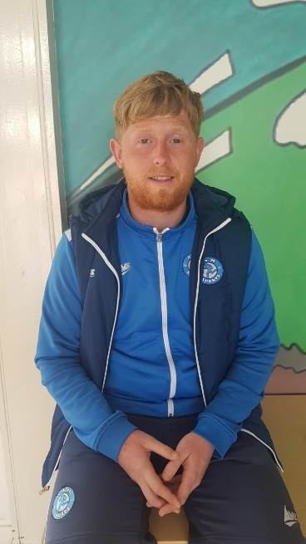
PE and Music
Your child will have PE on a Monday with Mr Soboljew and a Wednesday with Dan.
They will have Music on Wednesday with Mr. Hall.
On PE days, children are expected to come to school dressed in their PE uniform, with no ear-rings and long hair tied back.
Uniform:
Maroon t-shirt with Hillside lettering, plain black shorts
or tracksuit bottoms (no stripes or logos) and trainers
with plain socks.
Hair:
Long hair (below shoulder length) must be tied back.
Physical Education:
Earrings for PE:
All forms of body piercing MUST be removed before children take part in physical education or undertake any physical activities. If the body piercing is not removed the child will NOT be allowed to take part in any physical education lesson or activity.

Slide 8
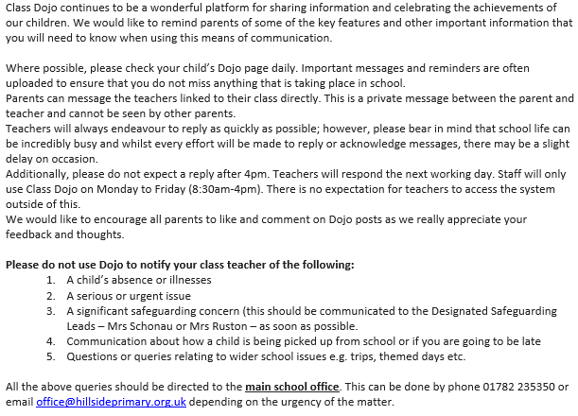
Communication – Dojo

Slide 9
Homework and Reading
Your child will be set Mathematics homework weekly and this will be linked to the learning from the week’s lessons. Within the homework their will be a warm-up which will link to fundamental skills in Year Five. Your child will also have access to TT Rock Stars to play at home if they choose which practises key skills. Your child is also required to complete one session as part of their weekly homework. The login will be in their reading diary.
Your child will also receive fortnightly English spelling homework, linked to the spelling rule they have been learning. This will give them the opportunity to practise their spelling. The homework will be set online via Spelling Shed. The login will be in their reading diary.
Your child is expected to read with you at home at least three times a week and this is to be noted in their reading diary. If they read five times a week they are entered in to the Reading Rocket and get a letter home, extra play and a chance to win a bigger prize! We also offer extra prizes to the class that has the most children entered in to the Reading Rocket!

Slide 10
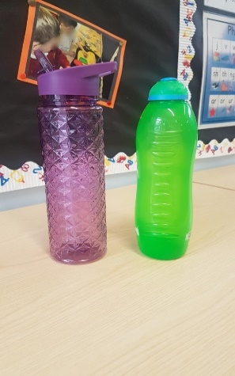
Reminders
Children are welcome to bring their own healthy snack in to eat at playtime. This can be a piece of fruit/ breakfast bar etc. (we are a nut free school so no items containing nuts and no chocolate/ crisps please)
Each child should have a water bottle in school each day (please no glass). This is to be taken home each day and brought back in refilled with water. It can be refilled throughout the day from our water dispensers.
PLEASE send your child with appropriate clothing for
the weather – coats, hats, gloves, sun hats, sun cream
as appropriate. Thank you!

Slide 11
Behaviour
Children are expected to follow our Hillside Rules to:
Stay Safe
Show Respect
Be kind
Positive behaviour is rewarded at Hillside in lots of ways including:
Marbles for top teams and individual behaviour!
End of the week treats!
Head Teacher Certificates and Good Worker Awards!
Prize draws for Reading Rocket…
We follow our behaviour consequence system if we need to (see in class) and this is used consistently throughout the school.

Slide 12
Extra-curricular Clubs NB: Dates and clubs will be confirmed closer to the events
Multi-skills with Dan
Plus lots more exciting opportunities throughout the year!

Slide 13
Any Questions?

